Slide 1
Amazon VPC
Amazon Virtual Private Cloud

Slide 2
Content:
Introduction
Networking Basics.
AWS VPC Architecture.
Practical Example.
Deleting VPC

Slide 3
1. Introduction.
Amazon VPC or Amazon Virtual Private Cloud is a service that allows its users to launch their virtual machines in a protected as well as isolated virtual environment defined by them. You have complete control over your VPC, from creation to customization and even deletion. It’s applicable to organizations where the data is scattered and needs to be managed well. In other words, VPC enables us to select the virtual address of our private cloud and we can also define all the sub-constituents of the VPC like subnet, subnet mask, availability zone, etc on our own.
We can place the necessary resources and manage access to those resources in the VPC, a private area of Amazon that we control.
A default “VPC” will be generated when we register an AWS account, allowing us to manage the virtual networking environment, the IP address, the construction of subnets, route tables, and gateways.

Slide 4
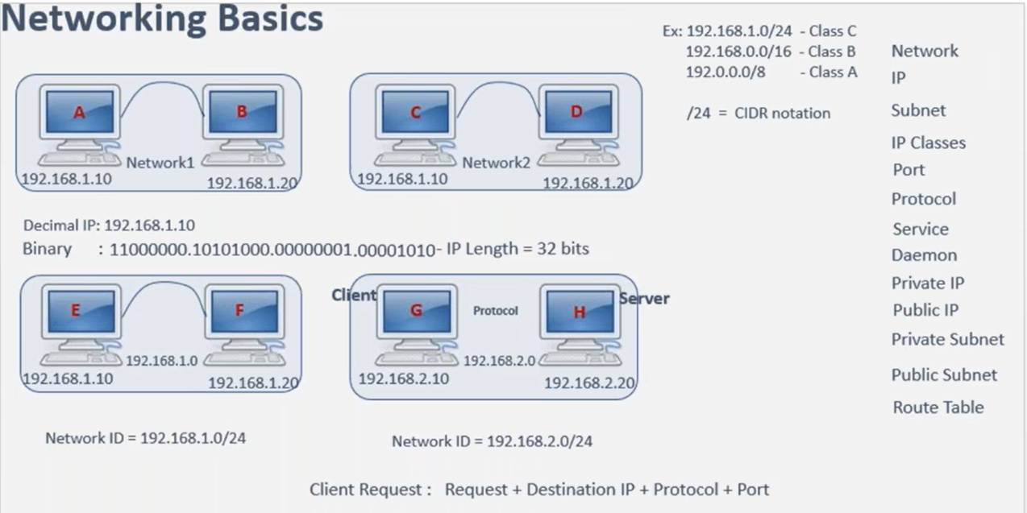
2. Networking Basics.
If the system is in the network, system has to be identified and has to be connected to other systems, then every machine or a system should have its own IP address. Let's say here I'm taking a machine IP address as 192.168.1.10 the B machine IP address I'm taking as 192.168.1.20.
Think of like the two systems are in the same data center right, and the two systems are assigned with its own IP address and the two systems are connected with a proper LAN cable, local area network cable and the two systems are able to talk to each other. When more than one system are in the communication then that is called as a Network.

Slide 5
So, our statement is A and B are two systems which are in network one which are identified with its own IP address same way, let's say in our data center probably you have a another system which is a C you have a another system which is d the C machine wanted to talk to a D machine and definitely the C machine should have its own IP address, the machine should have its own IP address when C and D are able to talk to each other, then definitely I would say that the C and D systems are in the network and let me call this as network two in this particular topology.
topology in the sense the way how you are putting the network connectivity and deciding which system should be able to connect to which other systems that SCADE that is the network topology.
The machines which are in the different network cannot be communicated with each other by default a and b are in the same network. So A and B can communicate each other C and D are in the same network C and D can we communicate with each other but the we cannot connect to the same machine as both are in the different networks all together.
in order to put a network connectivity between these systems, we cannot put a direct cable into each and every server rather we are using the network switch.

Slide 6
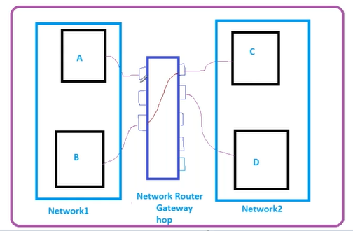
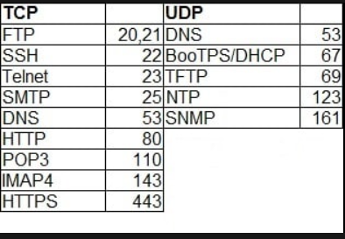
TCP, UDP Protocol, and port.

Slide 7
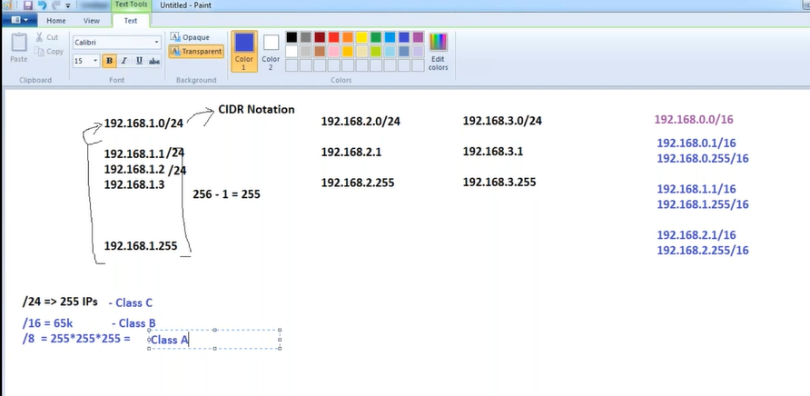
CIDR-> Classless inter domain routing system.
The CIDR block of a subnet can be the same as the CIDR block for the VPC (for a single subnet in the VPC), or a subset of the CIDR block for the VPC (to create multiple subnets in the VPC). The allowed block size is between a /24 netmask and /16 netmask. If you create more than one subnet in a VPC, the CIDR blocks of the subnets cannot overlap.
For example, if you create a VPC with CIDR block 192.168.1.0/24, it supports 256 IP addresses. You can break this CIDR block into two subnets, each supporting 128 IP addresses. One subnet uses CIDR block 192.168.1.0/25 (for addresses 10.0.0.0 - 10.0.0.127) and the other uses CIDR block 192.168.1.128/25 (for addresses 192.168.1.128 - 192.168.1.255).

Slide 8
There are tools available on the internet to help you calculate and create IPv4 subnet CIDR blocks. You can find tools that suit your needs by searching for terms such as 'subnet calculator' or 'CIDR calculator'. Your network engineering group can also help you determine the IPv4 CIDR blocks to specify for your subnets.
The first four IP addresses and the last IP address in each subnet CIDR block are not available for your use, and they cannot be assigned to a resource, such as an EC2 instance. For example, in a subnet with CIDR block 192.168.1.0/24, the following five IP addresses are reserved:
192.168.1.0: Network address.
192.168.1.1: Reserved by AWS for the VPC router.
192.168.1.2: Reserved by AWS. The IP address of the DNS server is the base of the VPC network range plus two. For VPCs with multiple CIDR blocks, the IP address of the DNS server is located in the primary CIDR. We also reserve the base of each subnet range plus two for all CIDR blocks in the VPC. For more information, see Amazon DNS server.
192.168.1.3: Reserved by AWS for future use.
192.168.1.255: Network broadcast address. We do not support broadcast in a VPC, therefore we reserve this address.
If you create a subnet using a command line tool or the Amazon EC2 API, the CIDR block is automatically modified to its canonical form. For example, if you specify 100.68.0.18/18 for the CIDR block, we create a CIDR block of 100.68.0.0/18.

Slide 9
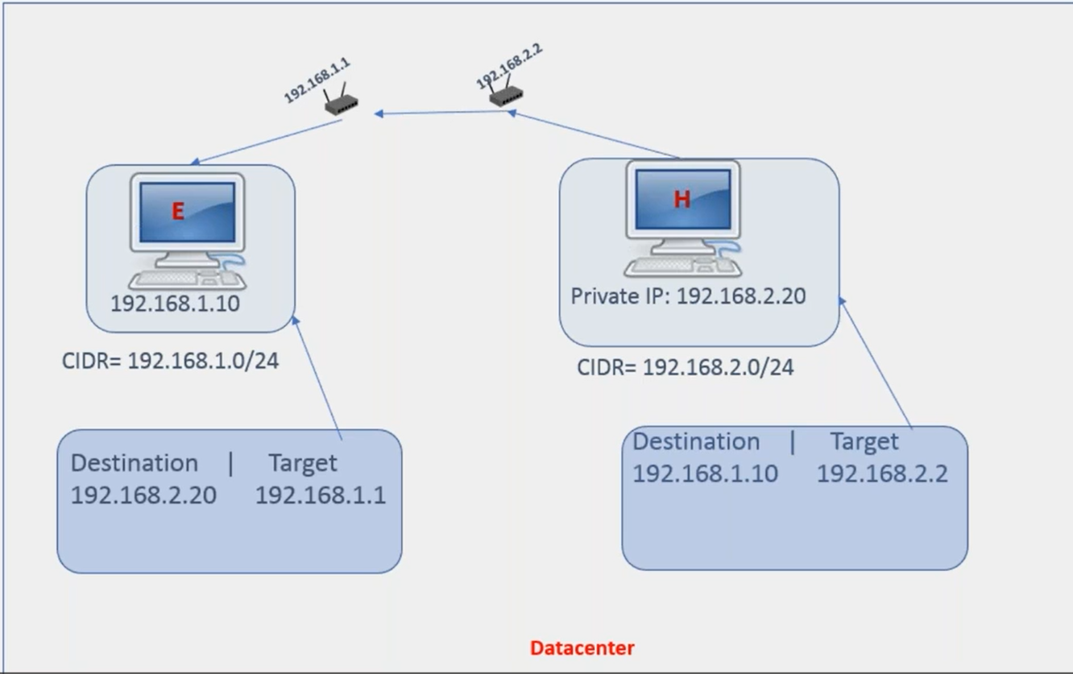
In this figure you can see that each network has its own gateway.
Each network contains its own rout table.
Route table contains Destination and target ip

Slide 10
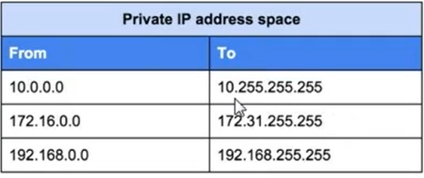
It says that, if you wanted to configure any private IP for your servers, then the IP should be within these ranges. if you're going for Class A, then the IP should start with a 10 and it should end with this number any number that belongs which is between 10.0.0.0 to 10.255.255.255, between these two numbers.
you take any IP that is a Class A private IP 172.16.0.0 to172.31.255.255,between these two number if you take any number that is treated as Class B private IP 192.168.0.0 to 192.168.255.255 And after that it could be any number this is the class C, private IP.
Same way, the IP that start with 10 is the universally identified cross a IP address which is clear which now other than that whatever you see the different numbers, all of them are considered as a public IPs case.

Slide 11
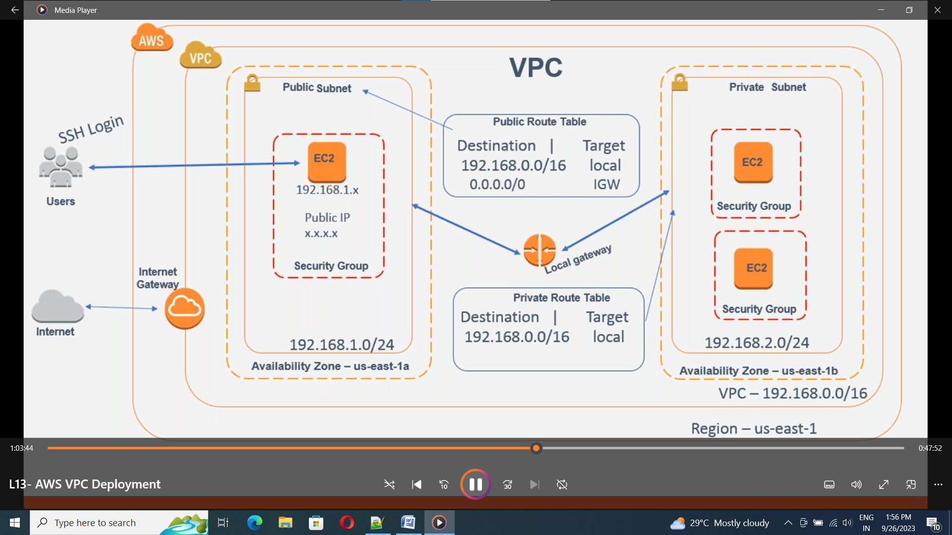
3. AWS VPC Architecture
VPC Components.
VPC.
Subnets
Private.
Public.
Route Tables.
Private.
Public.
Internet Gateway (IGW)
NAT Gateway.
Elastic IP Addresses.

Slide 12
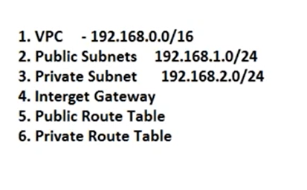
4. Practical Example.
Lets create the following components in the VPC

Slide 13
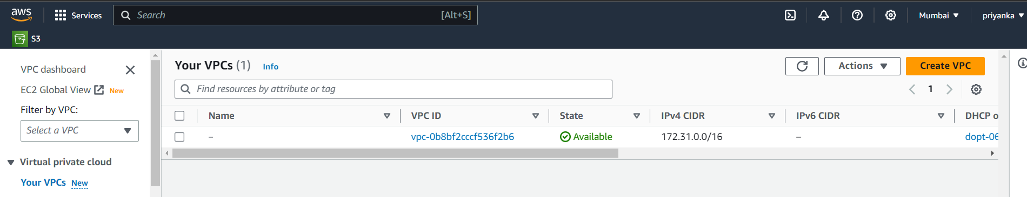
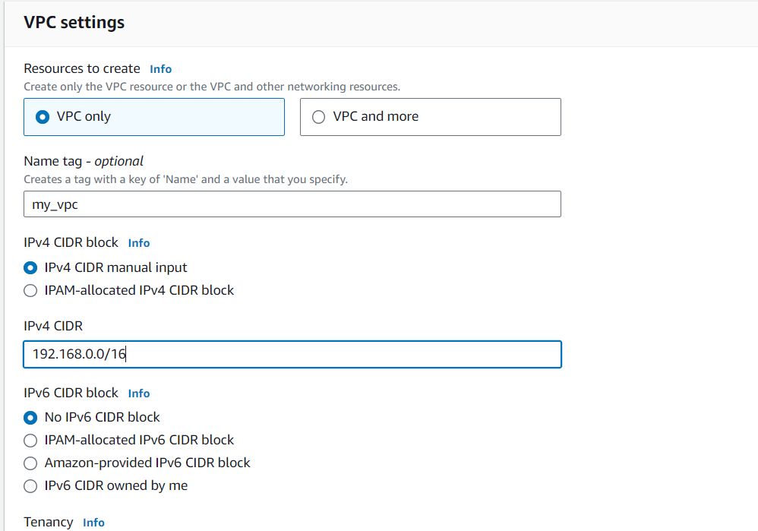
Step 1: Creating VPC.
AWS login>VPC > Your VPC >Create VPC
Enter vpc name
Enter IPV4 CIDR block
Network ip followed by netmask
I have entered 192.168.0.0/16
Where it allocates 2^16 instances
in my vpc.
Click on create VPC.

Slide 14
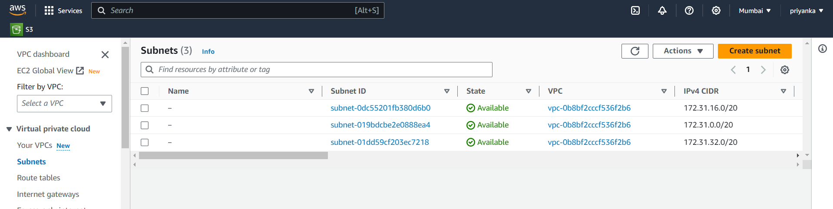
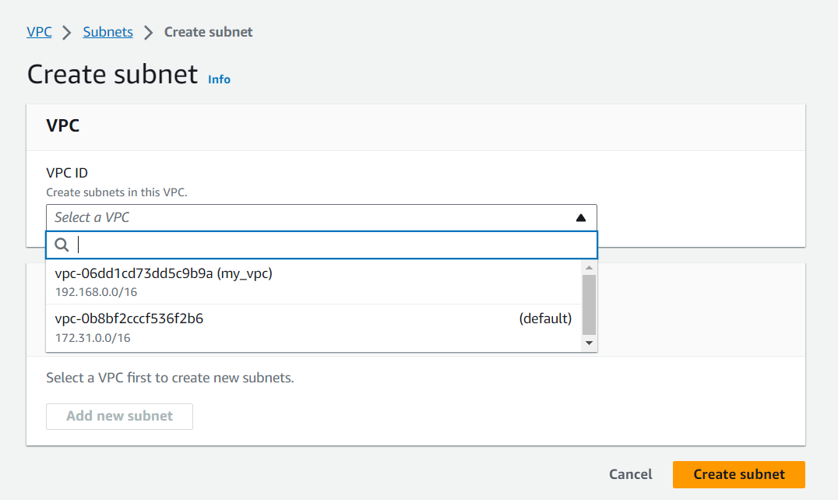
Step 2: Create Public Subnet.
Go to subnets > create subnet.
Select VPC that we have created.

Slide 15
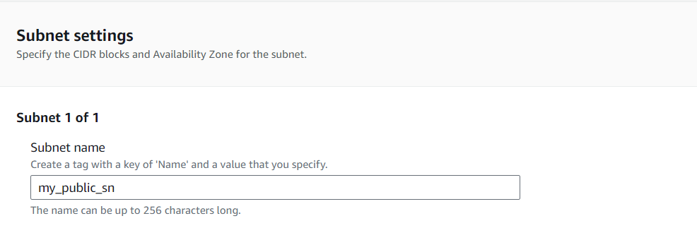
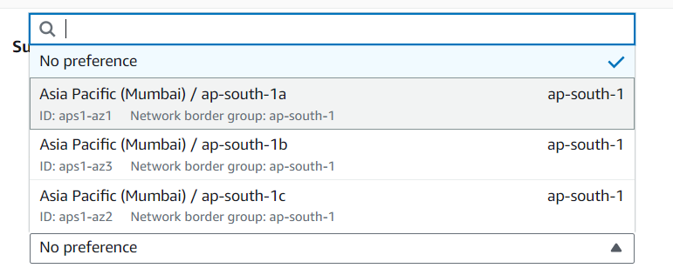
Enter subnet name.
Select preferred zone, that are available.

Slide 16
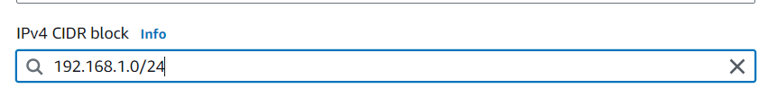
Enter the CIDR blok.
Click create create subnet.ck with the ip address and netmask.
Step 3: Create Private subnet.
Follow the step 2, change the subnet name and CIDR block ip, to 192.168.2.0/24.
As we have used 192.168.1.0/24 for public ip so we are not supposed to use the same ip in the same vpc.
Click on crate vpc.

Slide 17
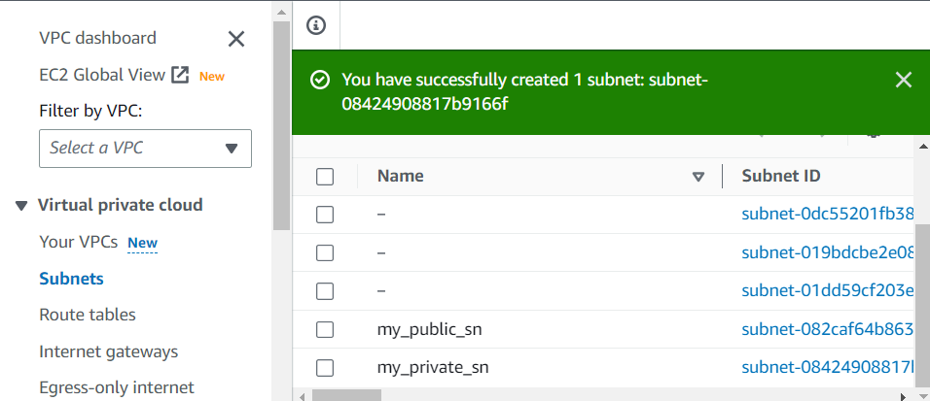
Your two subnets are created successfully.
Remaining subnets that we have are default subnets. Assigned by the AWS.

Slide 18
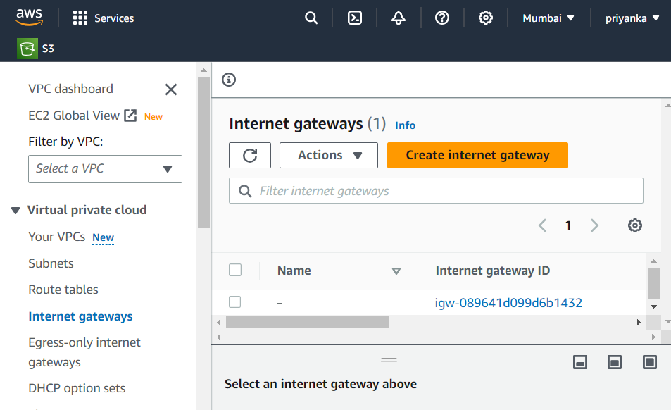
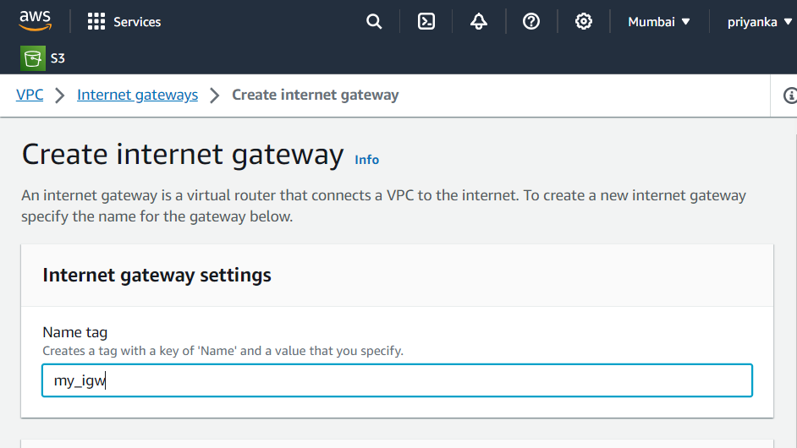
Step 4: create Internet Gateway.
Aws > VPC> Internet gateways.
Click on create Internet gateways.
Enter name tag.
Click on create gateway.
Your Internet Gateway is created.

Slide 19
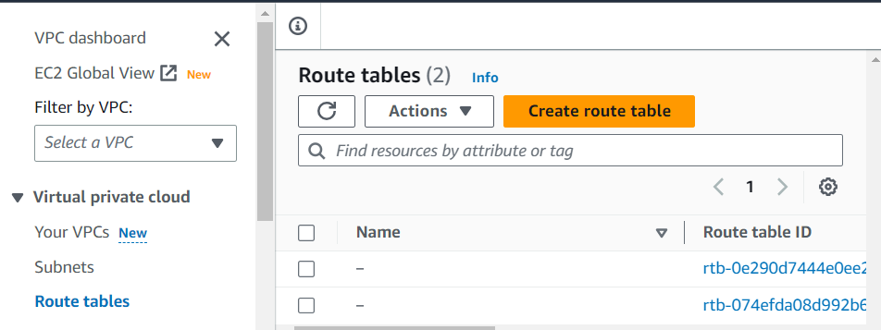
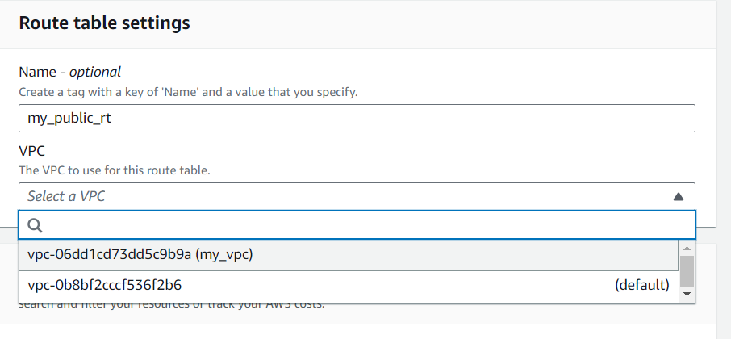
Step 5: create public route table.
Aws>vpc>Route Table.
Click on create route table.
Enter route table name.
Select VPC that we have created, and click on create route table.

Slide 20
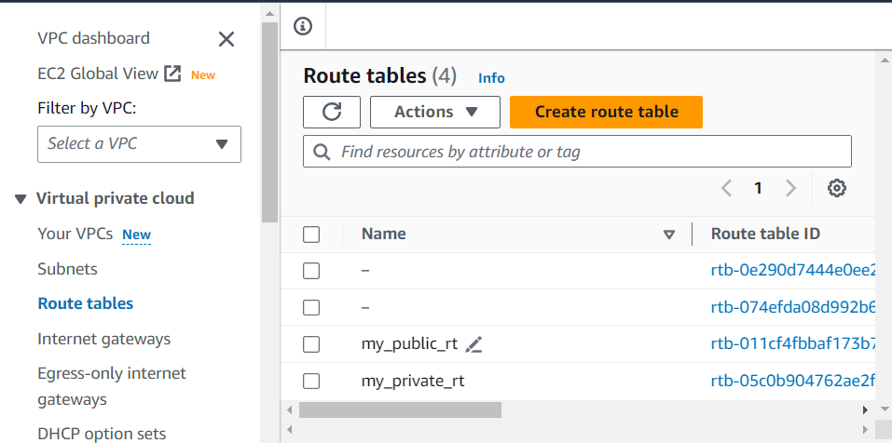
Step 6: create the private route table.
Follow the step 5 to create private route table.
Successfully we have created private and public route table.
Others are default route tables.

Slide 21
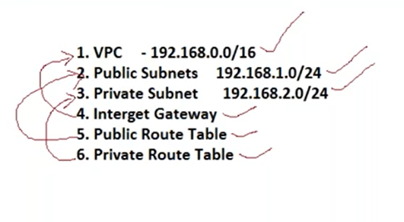
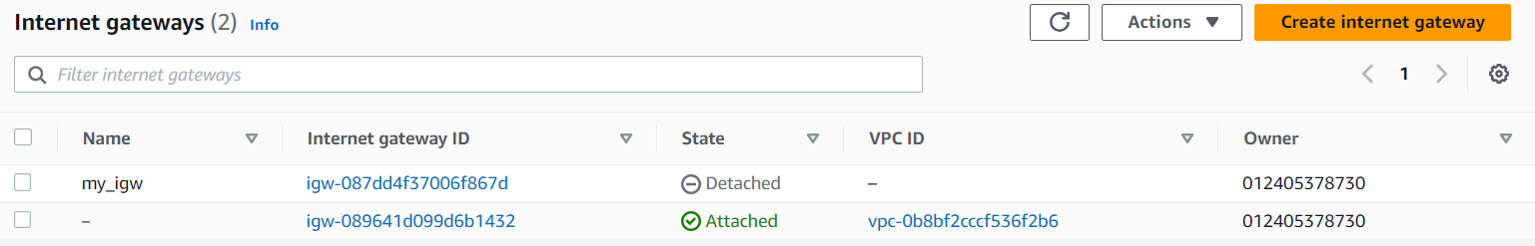
Now all the components are ready, but not yet connect to proper respective components.
To connect the components in a proper way lets follow the below figure
Step 7: Connect internet gate way to the VPC.
Aws>vpc>internet gateway.
By default our internet gateway will be in a Detached mode

Slide 22
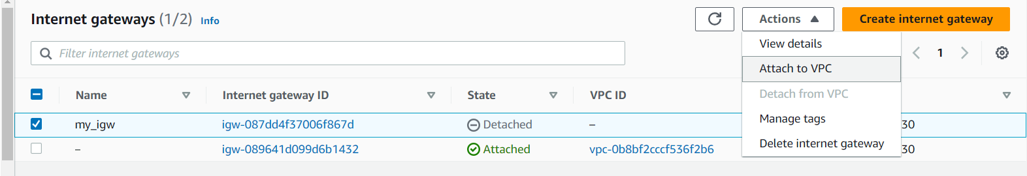
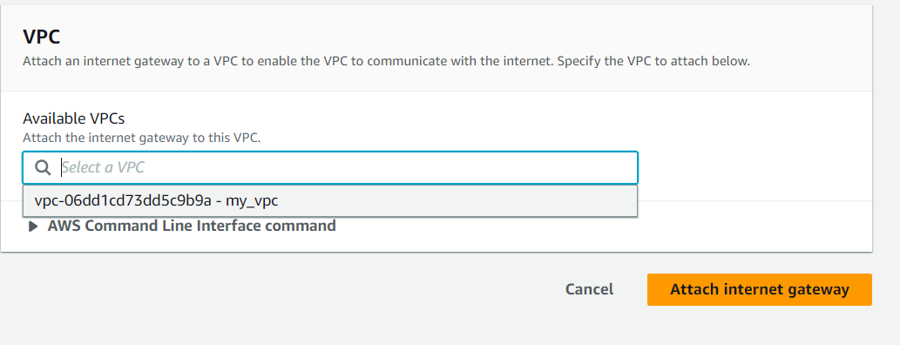
Select gateway, click on Actions, and Attach to VPC.
Select vpc, click on attach internet gateway.

Slide 23
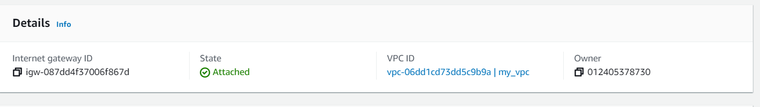
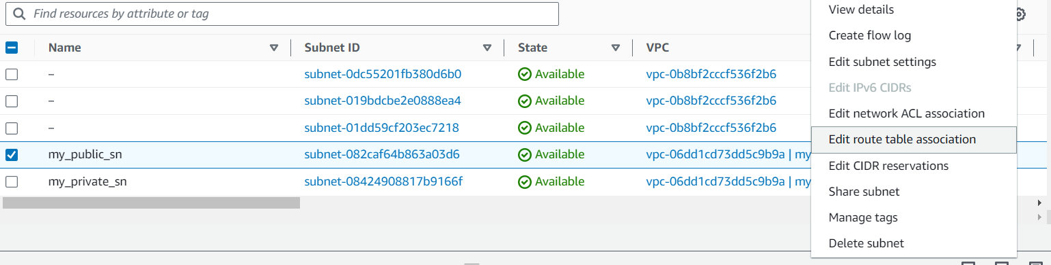
Now your internet gateway is active and attached to the VPC.
Step 8: Connect public route table to, public subnet.
Aws > VPC > subnets.
Select the subnet, click o actions, and click on edit route table association.

Slide 24
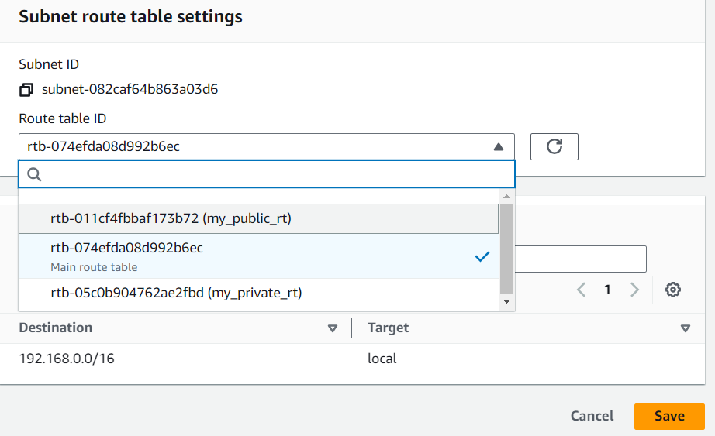
Select public rout table that we created.
Click on save.
Now your public route table is connect to public subnet.

Slide 25
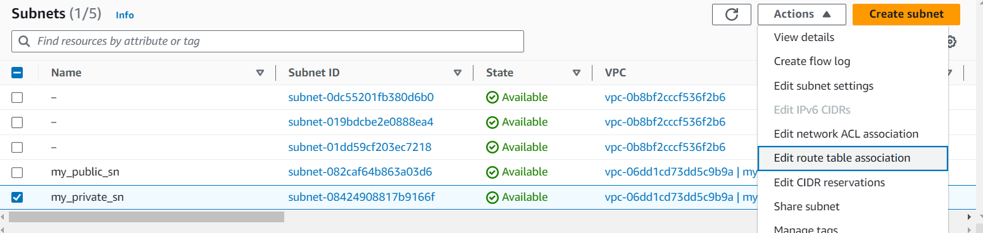
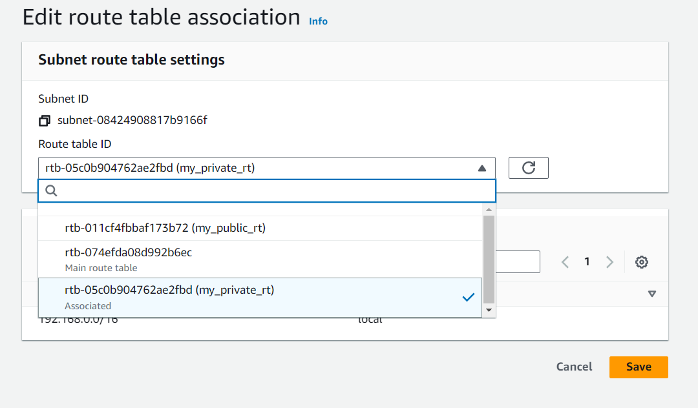
Step 9: Connect private route table to, private subnet.
Aws > VPC > subnets.
Select the subnet, click o actions, and click on edit route table association.
Select private rout table that we created.
Click on save.
Now your public route table is connect
to private subnet.

Slide 26
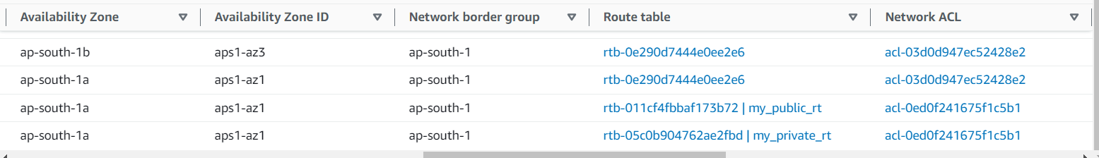
Now your subnets are connected to the corresponding route tables.

Slide 27
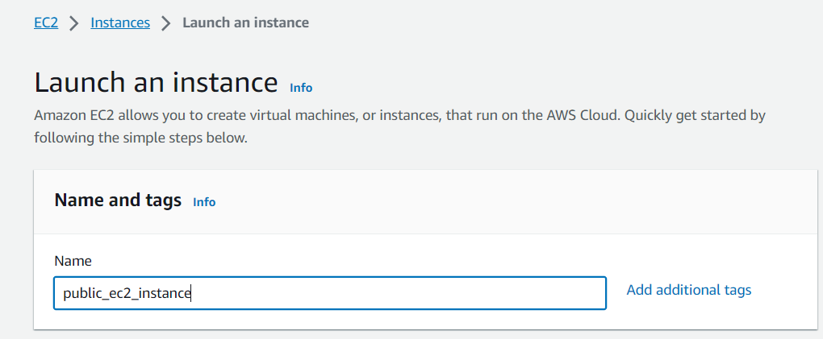
Now lets see how this vpc works when we create an ec2 instance, and check the behavior.
Lets create a 2 EC2 instances.
Public_ec2_instance.
Private _ec2_instance.
Go to AWS>EC2>instances> launch Instance.

Slide 28
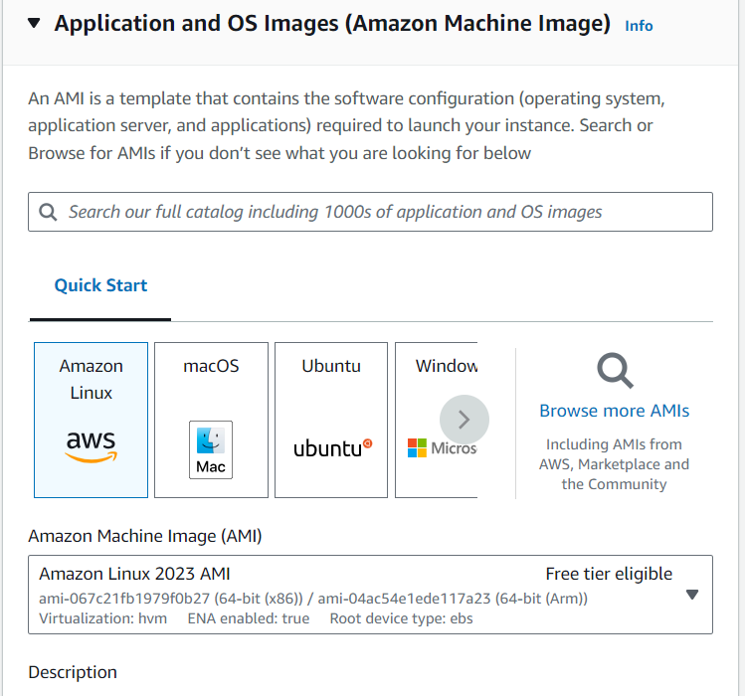
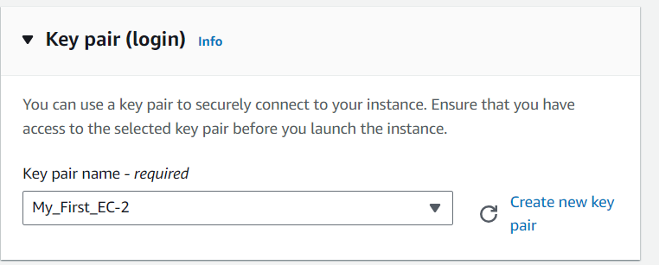
Select AMI, Amazon Linux machine. Select AMI Amazon Linux 2
Select existing key pair.

Slide 29
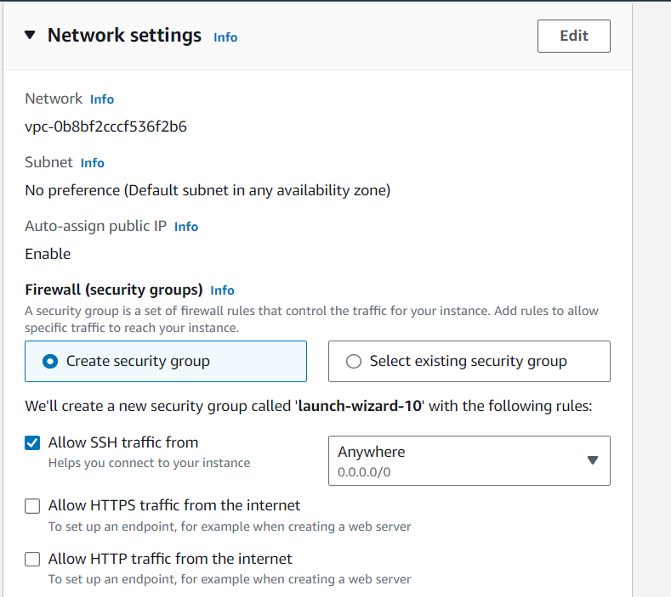
Now in networking settings you need to configure vpc, and subnets.
Click on Edit option.

Slide 30
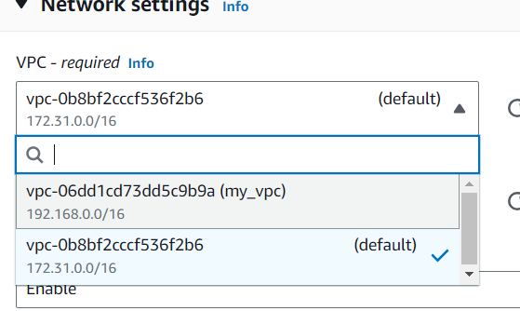
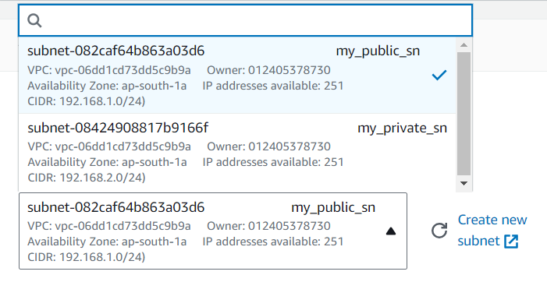
Select the vpc that we have created “my_vpc”.
Select Public subnet that we have attached to our vpc.

Slide 31
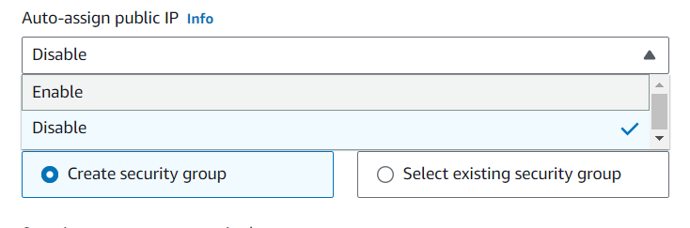
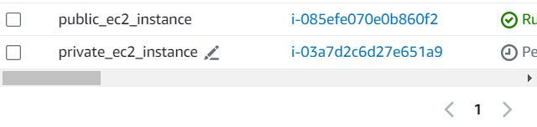
As we are creating the public ec2-instance, so enable Auto-assign public ip.
Click on Launch instance.
Your public ec2 instance is created.
Now same way create the private ec2 instance, and as we are creating the private instance disable the Auto-assign public ip.
Successfully we have created ec2 instances.

Slide 32
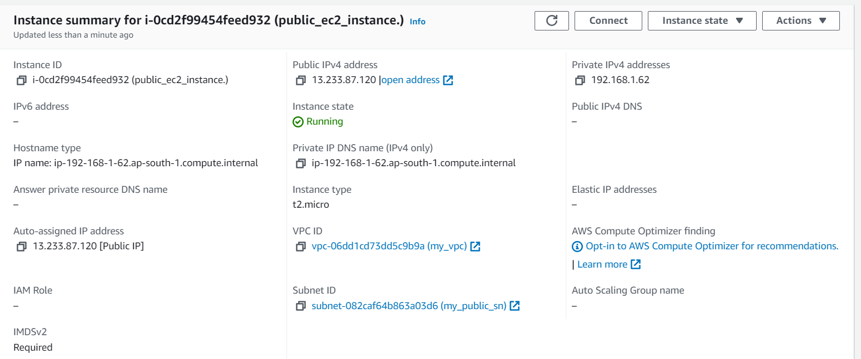
This is the summery of the “public_ec2_instance”.
Public address: Auto-assigned ip address ( you can see that Auto-assigned ip address and public ip address are same).
VPC -> my_vpc.
Subnet -> my_public_sn.

Slide 33
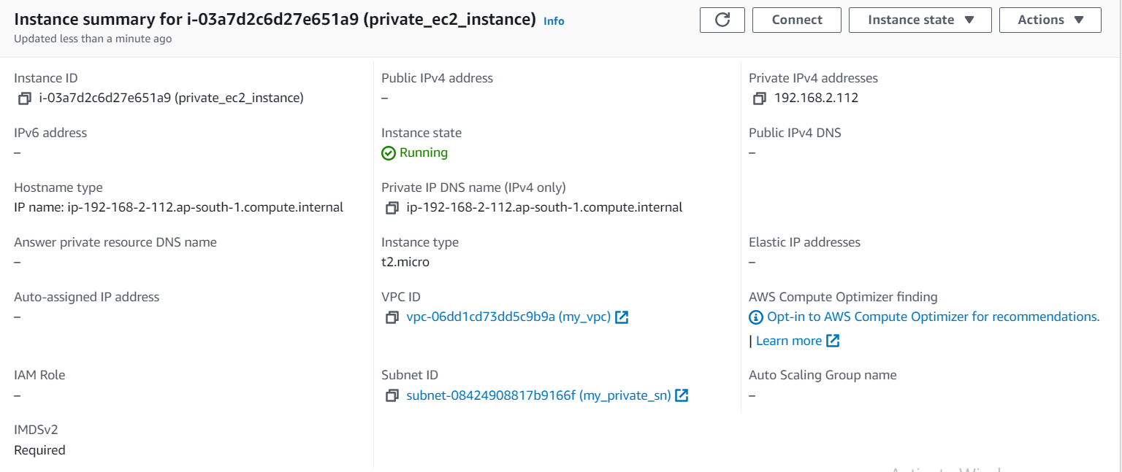
This is the summery of the “private_ec2_instance”.
As we have disabled the public ip, so public ip is not assigned to this instance.
VPC -> my_vpc.
Subnet -> my_private_sn.

Slide 34
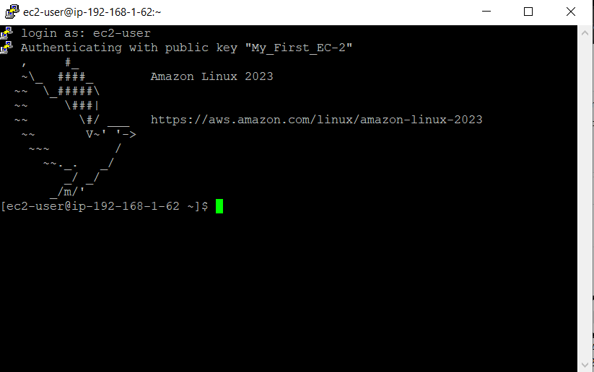
Lets take a scenario where you want to launch the private ec2 machine global.
Public ec2 instance can access the private ec2 instance as they are in the same local network vpc.
So to launch the private ec2 instance you need to launch the public ec2 instance in the putty, after your in the public ec2 terminal you need to launch the private ec2 instance.
Lets launch the public ec2 instance with the public ip address.
This is our public ec2 instance.

Slide 35
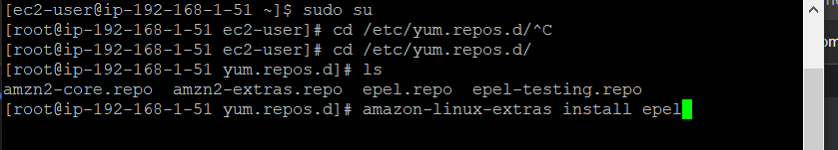
Now lets launch the private ec2 instance.
To launch any instance you need following parameters.
Ip address ->public or private.
Key pair > windows to linux (.”ppk”), linux to linux (“.pem”)
As we are lunching the private linux in public linux machine we need to have “.pem” file, but we have downloaded “.ppk” file.
To convert from “.ppk” to “.pem” or vise versa, we use puttygen.
Now lets download puttygen in the public ec2 instance.
Go to root “sudo su –”
Change directory to /etc/yum.repos.d/ : “cd /etc/yum.repos.d/”
As puttygen is a extra package, so to install it we need to install epel (Extra Packages for Enterprise Linux). : “amazon-linux-extras install epel”

Slide 36
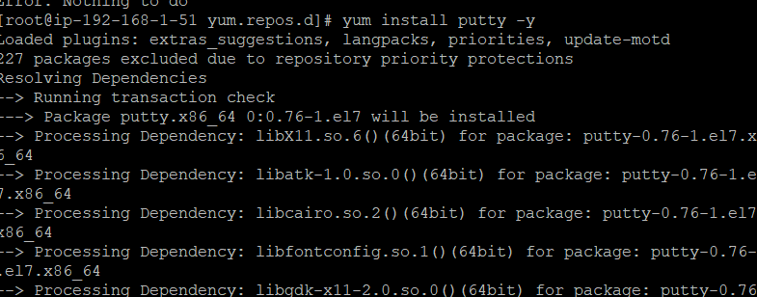
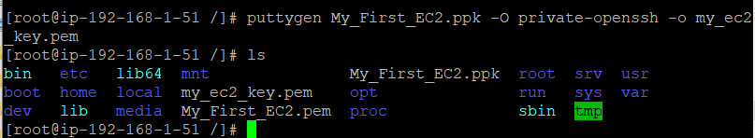
Now install putty: “yum install putty –y”.
Now create a file with your vi editor, copy ppk file content, and paste the content in vi editor.
Now to convert .ppk to .pem file run below command.
“puttygen file_name.ppk –O private-openssh –o file_name.pem”

Slide 37
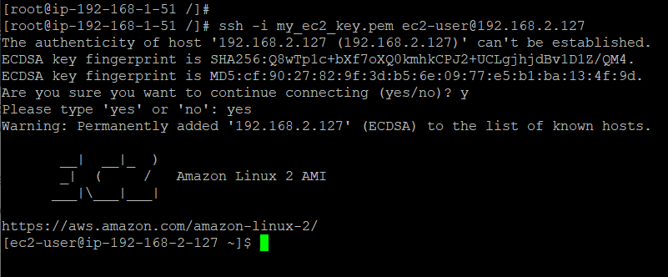
Now to launch the private instance follow the below command.
“ssh –i pem_file.pem e2-user@private_address”.
Now we have successfully launched the private ec2 instance publically via public ec2 instance.

Slide 38
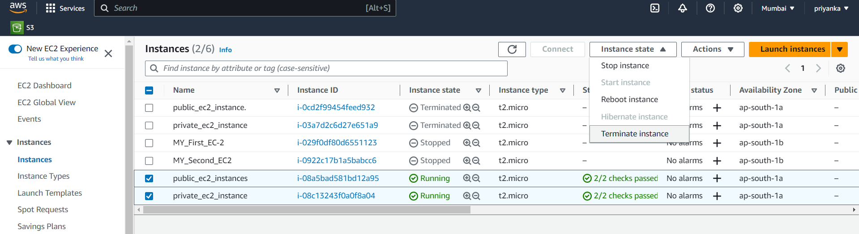
5. Deleting vpc.
Step 1: terminate ec2 instances.
Aws>ec2>select instances> actions> terminate.

Slide 39
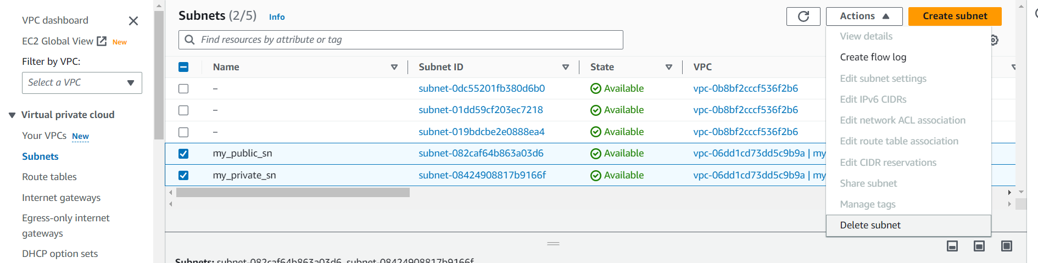
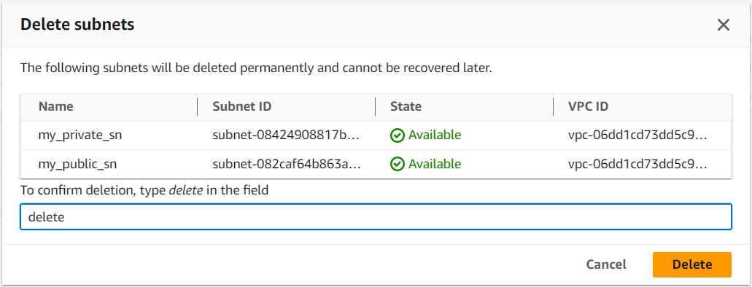
Step 2: delete vpc subnets.
Vpc>subents>select subnets>actions>delete subnet.

Slide 40
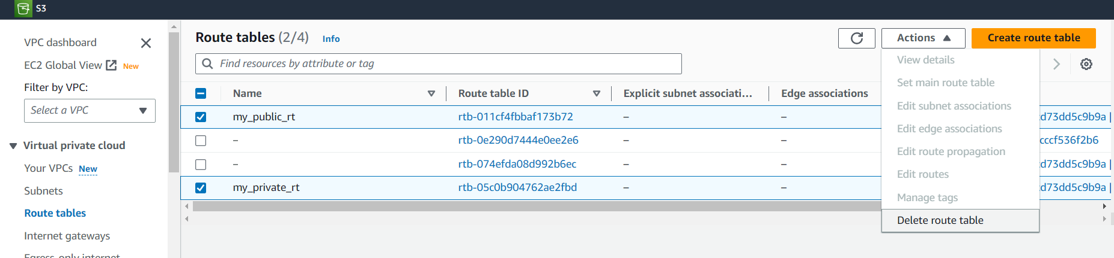

Step 3: delete Route Table.
Aws > vpc > routetable > select route tables>actions> delete route table.

Slide 41


Step 4: Detach Internet gateway from VPC.
Aws > VPC>Interent GateWay >select your gateway>actions> Detach from VPC.

Slide 42


Step 5: Delete Internet GateWay.
AWS> vpc>internet gateway>select internet gateway> Actions> Delete Internet gateway.

Slide 43


Step 6: delete VPC.
Aws > VPC>select VPC>actions> Delete VPC.

